Slide 1
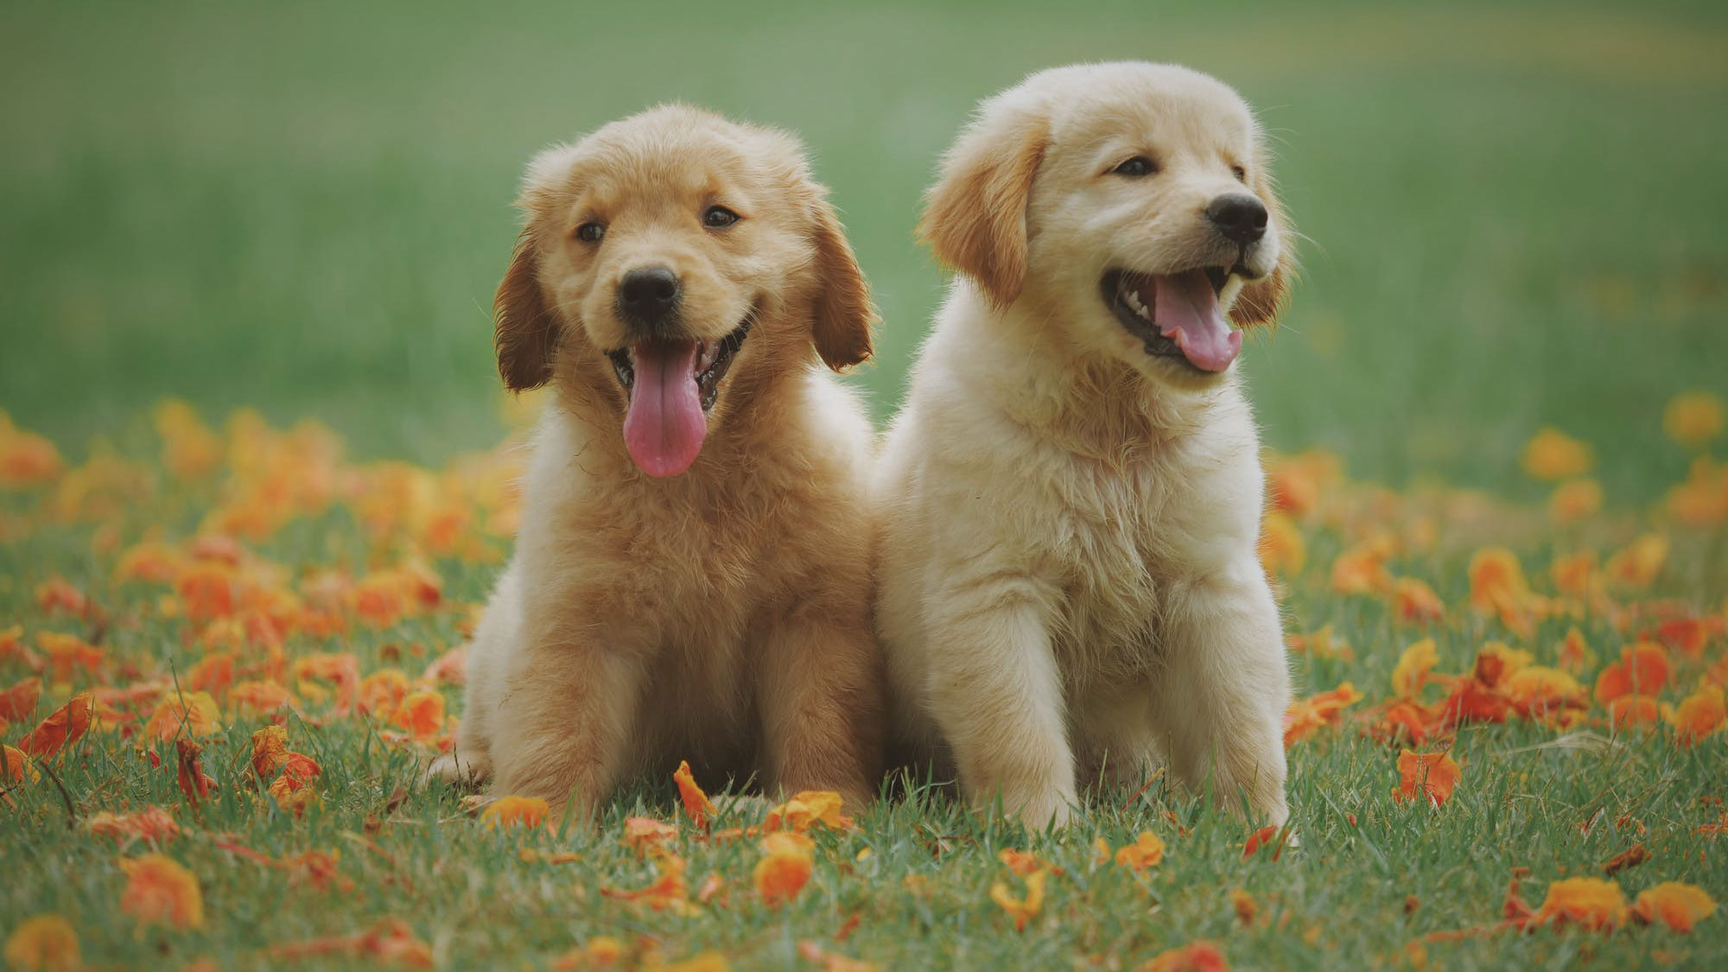
World’s favorite pet dogs!
Presented by Sowmya Chavali
Bellevue University

Slide 2
Dog Breeds
There are over 350 dog breeds in the world.
Organizations which promote breed standards are AKC (American Kennel Club) and UKC (United Kennel Club).
AKC recognizes 195 breeds ,with 79 additional breeds working toward full recognition and UKC recognizes 300 breeds as of 2020.

Slide 3
Top 5 dog breeds according to AKC
The AKC released its most popular dog breeds list in U.S., on May 1, 2020 based on 2019 AKC registration statistics.
Retrievers (Labrador)
German Shepherd Dogs
Retrievers (Golden)
French Bulldogs
Bulldogs
Labs top the AKC’s list for the 29th year in a row.

Slide 4
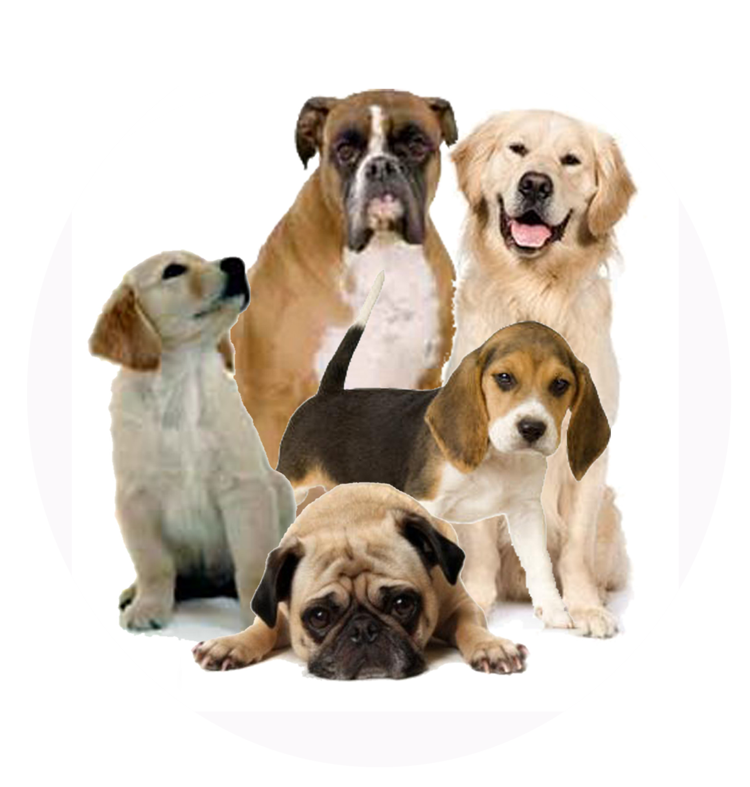
Groups
Breed groups bring together dogs that share similar traits.
AKC Recognized Breeds are assigned to one of seven groups or the Miscellaneous Class
Working
Sporting
Non-Sporting
Toy
Herding
Terrier
Hound
Miscellaneous

Slide 5
Working Group - Big and strong these dogs were bred as guard dogs, work dogs and rescue dogs..
Breeds include Siberian Husky, Doberman Pinscher and Great Dane.
Sporting Group - Bred as hunting dogs, they love field activities – especially in water or in woods.
Breeds include pointers, setters, retrievers and spaniels.
Non-Sporting Group - This group is very loosely defined and contains breeds that simply don’t fit neatly into any other.
Breeds include Keeshond, the Chow Chow, the Dalmatian and the French Bulldog.
Toy Group - The dogs in this group share two features: size (small or very small) and delightful looks.
Many of these breed bark ferociously and they’re as tough as leather.
Breeds include Chihuahua, Pomeranian, Poodle.

Slide 6
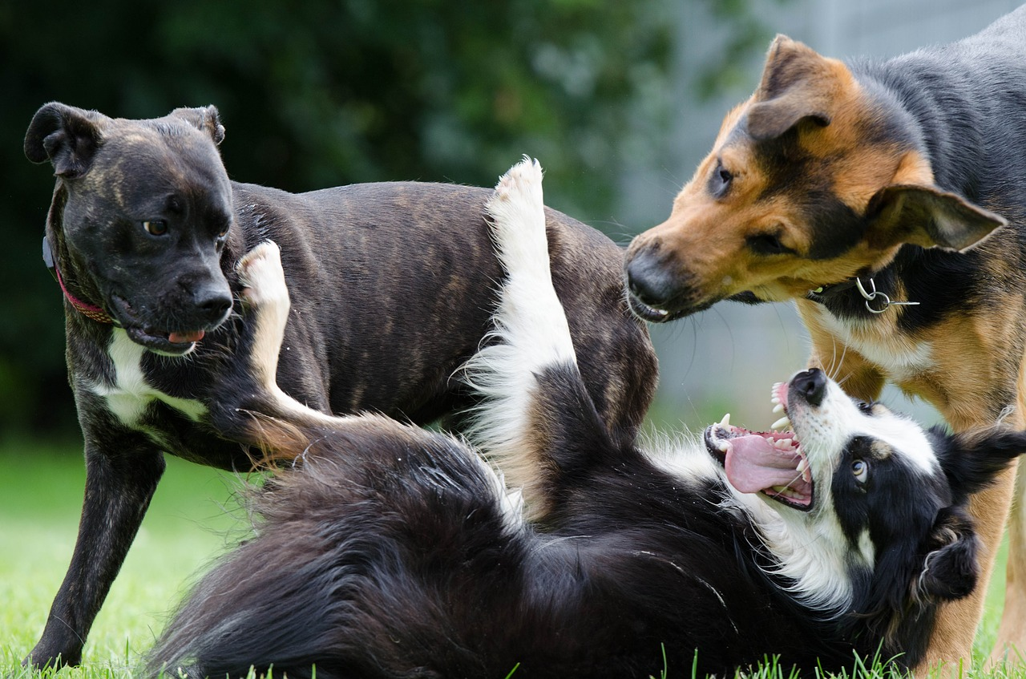
Herding Group - Herding breeds share an instinctual ability to control the movement of other animals.
Breeds include German Shepherd, Corgi etc.
Terrier Group - Terriers are determined, energetic and generally intolerant of other.
Breeds include Bull terrier, Cairn terrier.
Hound Group - Breeds in this group are hunters. Many hounds bay rather than bark
Breeds include Greyhound, Beagle.
Miscellaneous - Biewer terrier, Dutch Shepherd, Mudi

Slide 7

Instead of limiting ourselves to the U.S., lets find out the most popular dog breed in the entire world?

Slide 8
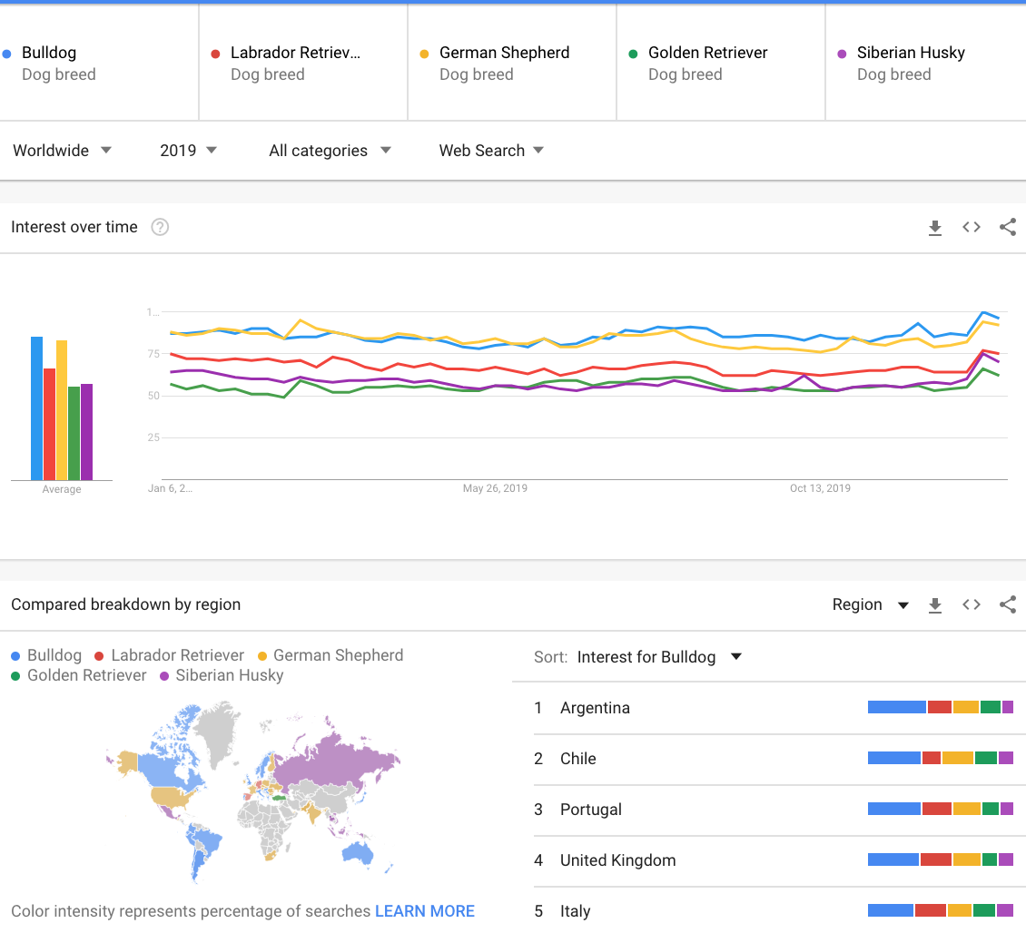
The Top 5 AKC dog breeds and their popularity in the world as per google trends for 2019.
Trends shows that Bulldog tops the list in world popularity.
Labrador the top ranker as per AKC settles at 3rd place in its popularity in the world.

Slide 9
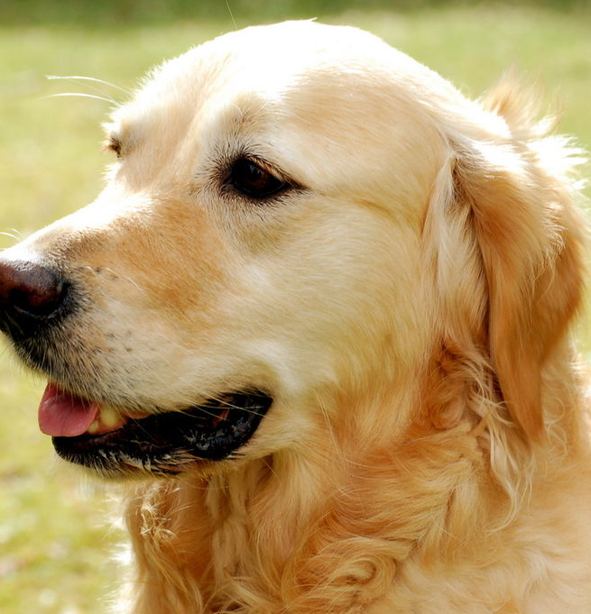
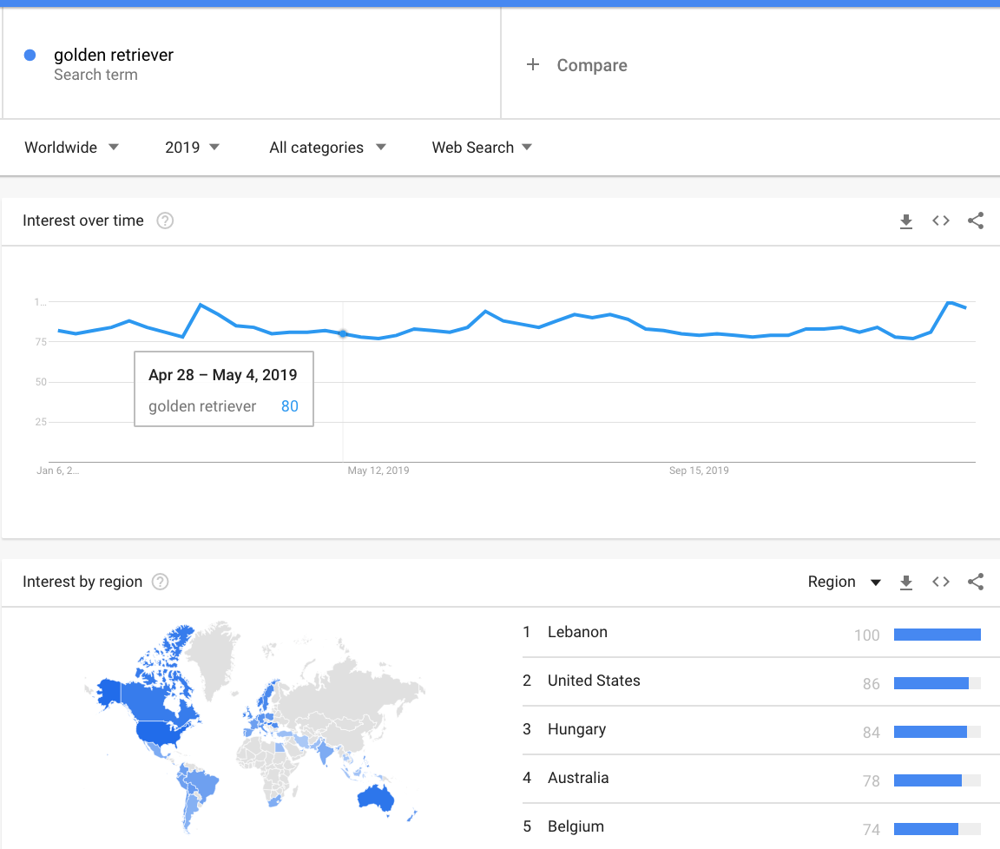
Golden Retriever
World rank – 5 as per Google trends
AKC rank – 3
Sporting Group
Countries/regions most popular in: Lebanon, United States, Hungary.
Temperament - A loving, playful and outgoing dog the Golden Retriever gets along with everybody. He loves being outdoors or going on the dog treadmill!
Training -Despite his playfulness the Golden Retriever is a good learner, he picks up new commands quickly making it easy to train him.
Celeb owners: US Presidents Ford and Reagan (official White House dog), Jackie Chan, Dan Marino, Pamela Anderson, Oprah Winfrey, Ricky Martin, George Michael, Tom Cruise.

Slide 10
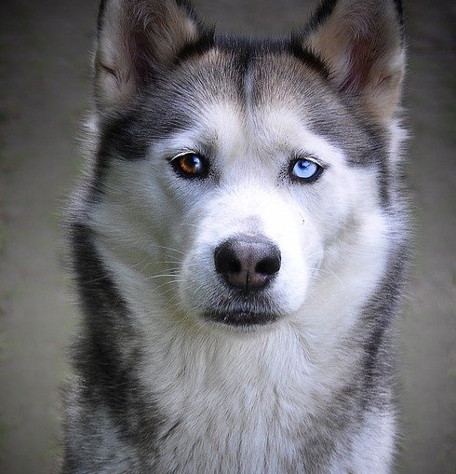
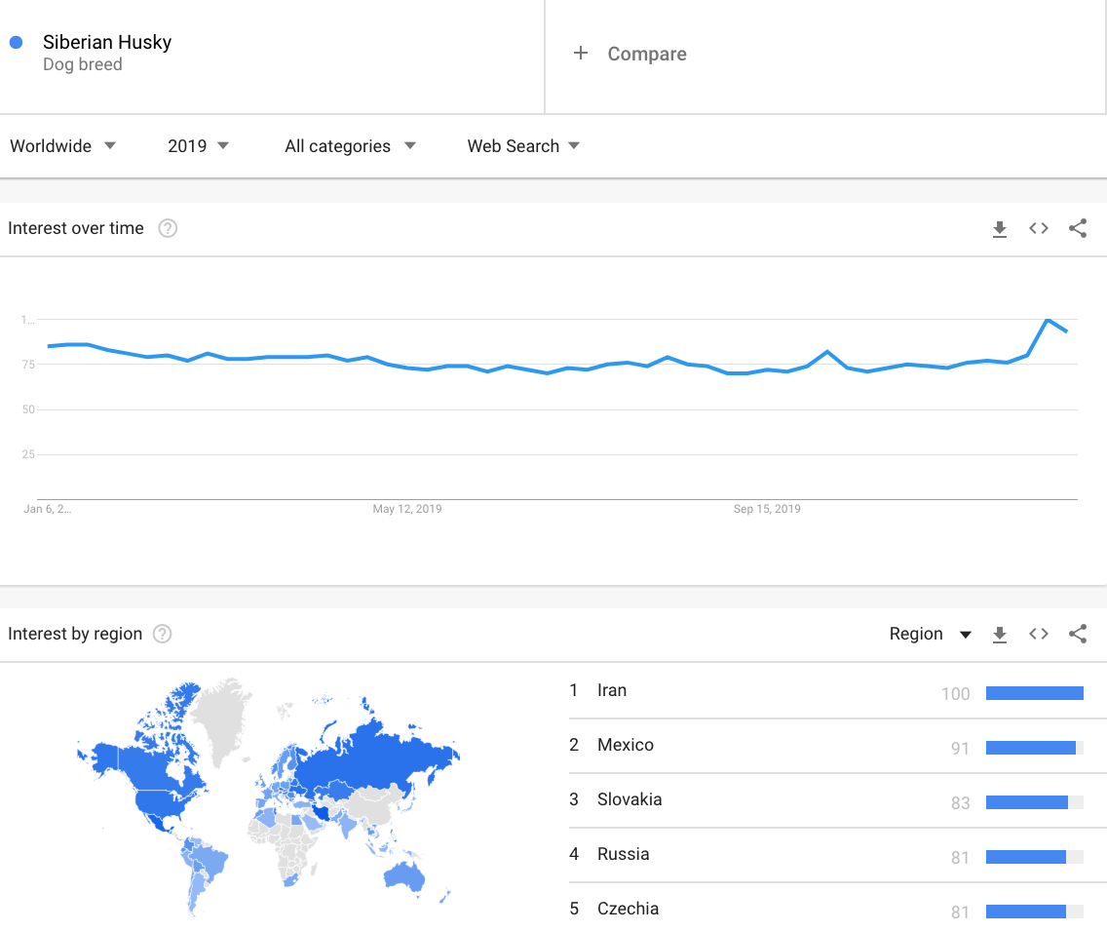
Siberian Husky
World rank – 4 as per Google trends
AKC rank – 15
Working Group
Countries/regions most popular in : Iran, Mexico, Slovakia, Russia
Temperament - outgoing, friendly and loyal. They are very willing and high-endurance workers
Training - Responds well, learns fairly quickly.
They recently experienced a surge in popularity due to their similarity to the fictional dire wolves featured in Game of Thrones
Celeb owners - Taylor Lautner, Rita Ora, Ben Stiller, Ashlan Gorse, Lesley-Ann Brandt, Russell Westbrook, Quincy Pondexter, Danica Sue Patrick.

Slide 11
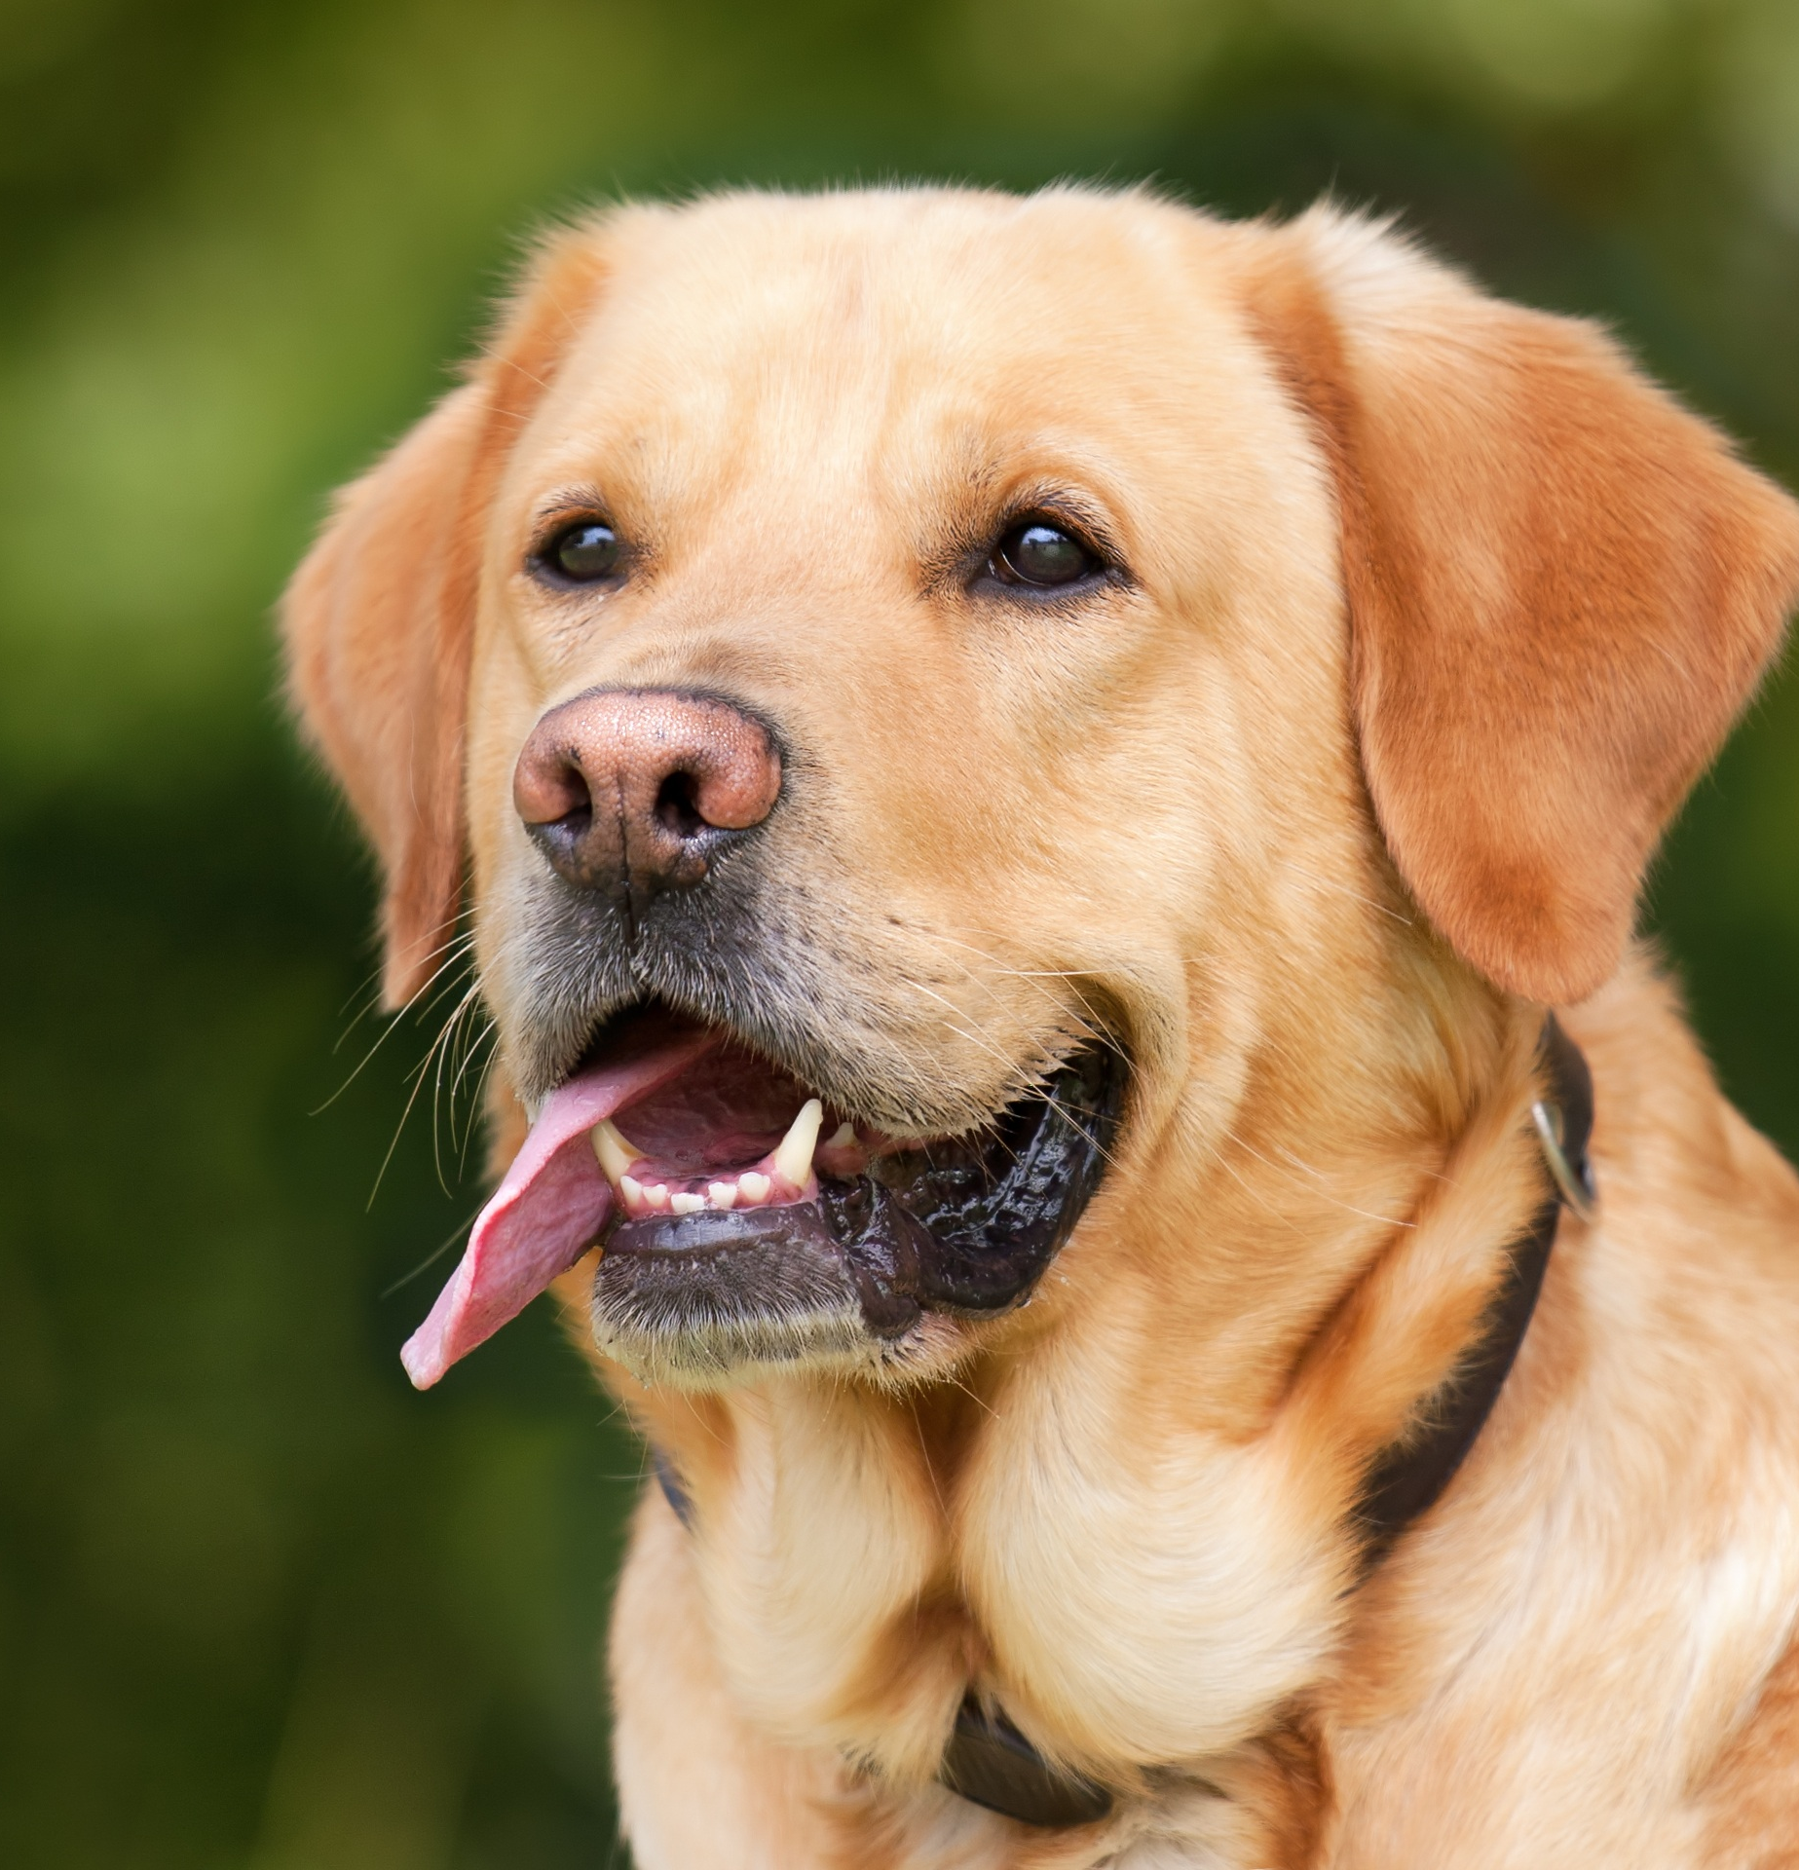
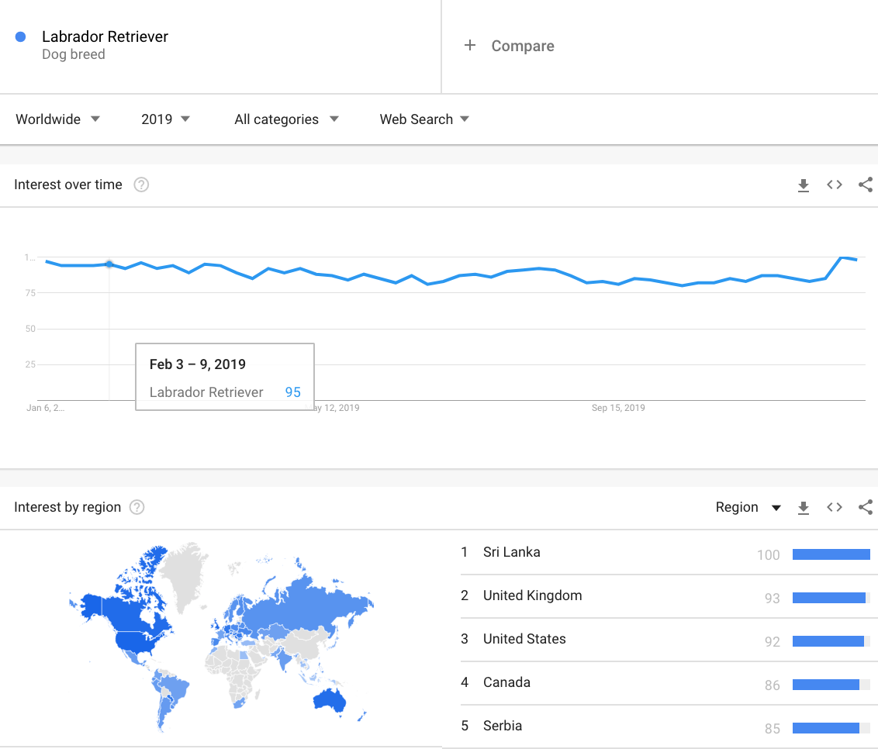
Labrador Retriever
World rank – 3 as per Google trends
AKC rank – 1
Sporting Group
Countries/regions most popular in: Sri Lanka, United Kingdom, United States.
Temperament - friendly, affectionate, good-natured dogs.
Training – Intelligent, learns commands quickly and the easiest of dog breeds to train
Celeb owners: Lots of celebs love the Lab! Prince Charles, Sylvester Stallone, Shannen Doherty, Keith Richards, Harrison Ford, Bill Clinton, Arnold Schwarzenegger, Frank Sinatra, Tom Cruise, Barbara Mandrell, and Vladimir Putin.

Slide 12
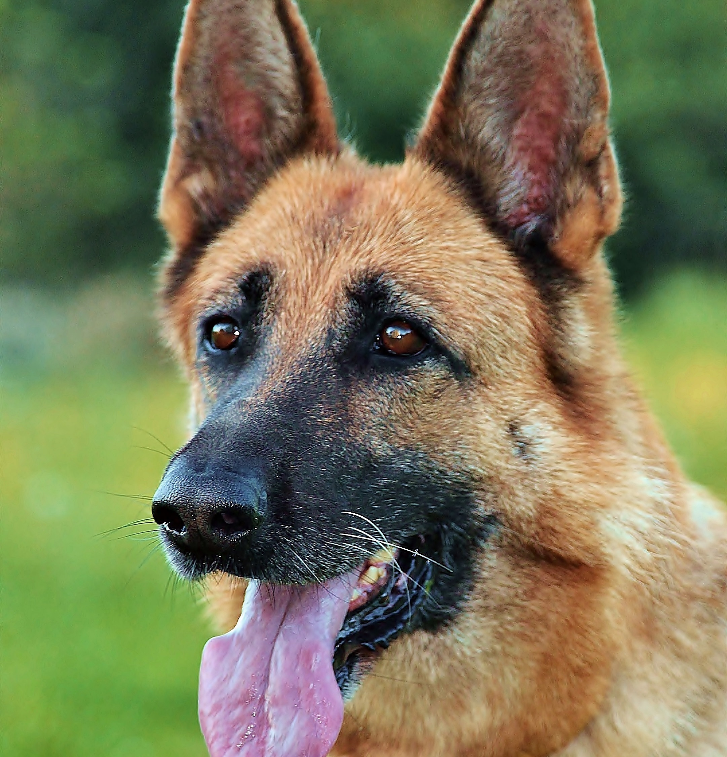
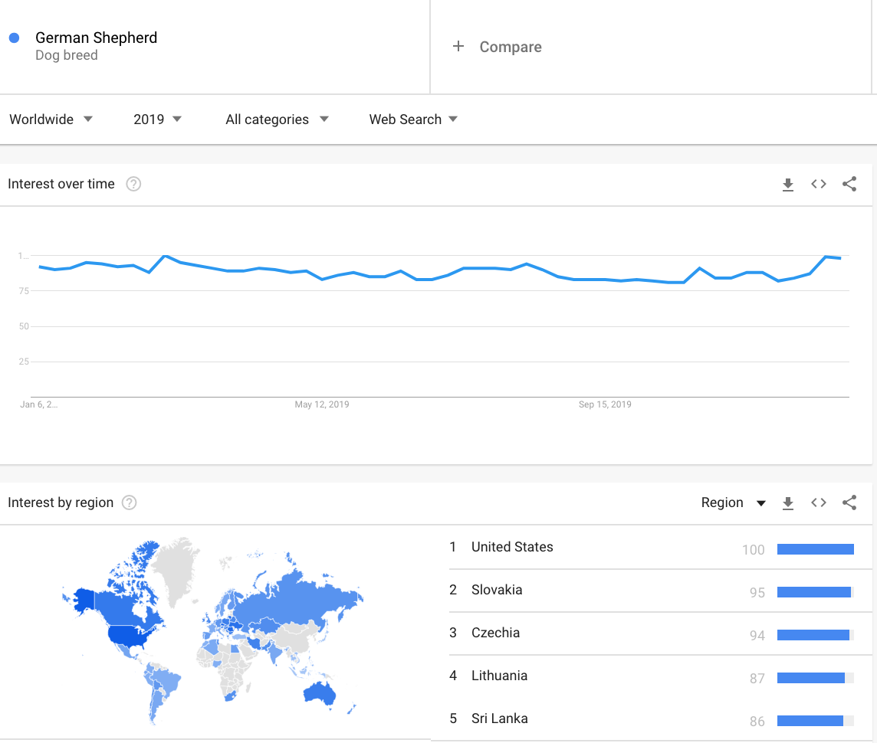
German Shepherd
World Rank 2 as per Google trends
AKC Rank - 2
Herding Group
Countries/regions most popular in: United States, Slovakia, Czechia
Temperament - strong, brave and loyal breed.
Training - They are very intelligent and easy to train.
Celeb owners : Reese Witherspoon, Jennifer Lopez, Kristen Stewart, Miley Cyrus, Bella Thorne, Claudia Schiffer, Jennifer Aniston, Enrique iglesias, Taylor Lautner, Tom Hanks

Slide 13
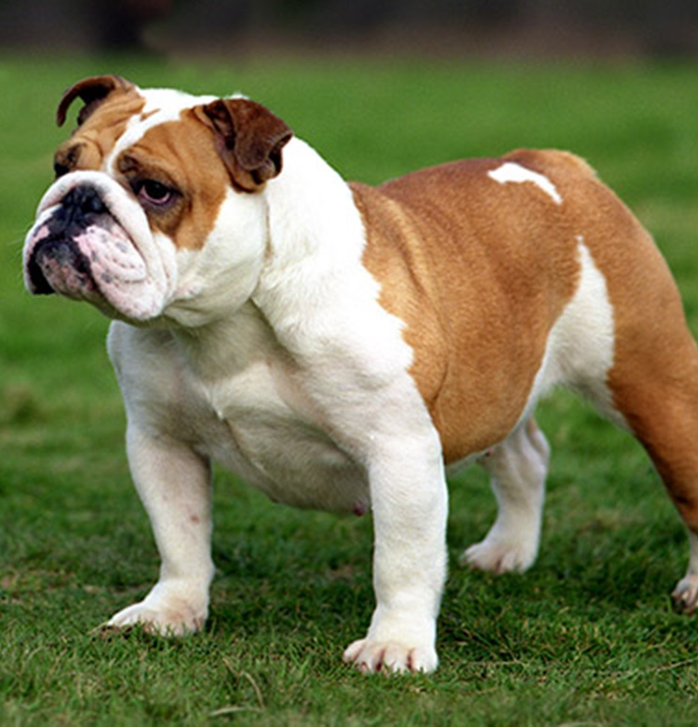
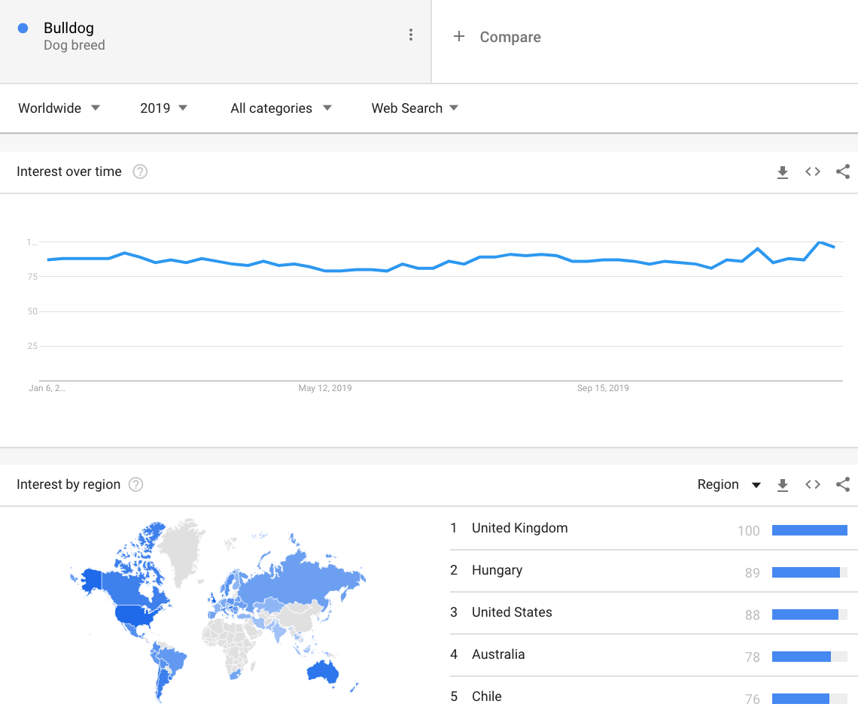
Bulldog
World rank -1 as per Google trends
AKC rank - 5
Non-sporting
Countries/regions most popular in according to Google trends: United Kingdom, Hungary, United States
Temperament -The bulldog knows its own mind and makes its own decisions! He’ll obey your commands – if he wants to.
Training - Training him can take a while. He won’t usually reach levels of obedience unlike other breeds.
Celebs who owned bulldogs: President Warren G Harding, Leonardo DiCaprio, Zac Effron, Brad Pitt, Martha Stewart, Adam Sandler, Olivia Wilde, Winston Churchill, Michael Phelps

Slide 14
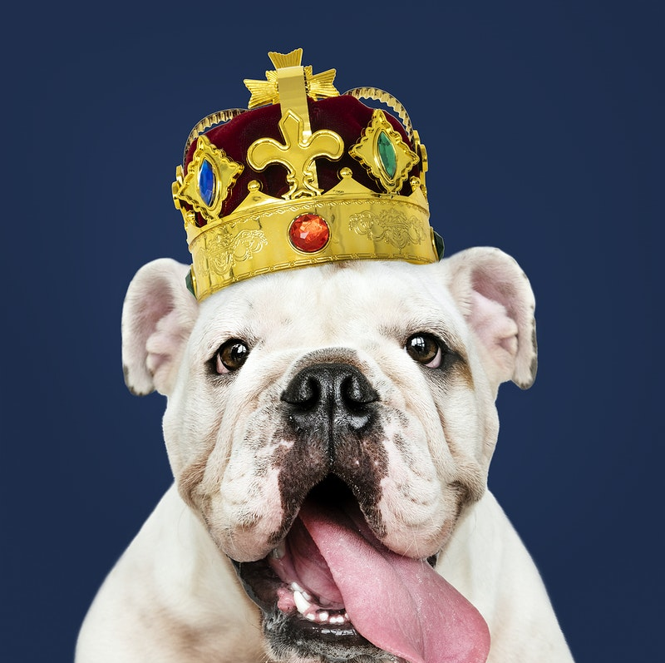
Congratulations Bulldog!
The Bulldog takes the crown for the most popular dog breed in the world, according to Google Trends 2019 data – narrowly beating the German Shepherd and Labrador Retriever.

Slide 15
References
1. The Most Popular Dog Breeds of 2019, https://www.akc.org/expert-advice/dog-breeds/2020-popular-breeds-2019/
2. The 7 AKC Dog Breed Groups Explained, https://www.akc.org/expert-advice/lifestyle/7-akc-dog-breed-groups-explained/
3. Breed Temperament Guide,https://s3.amazonaws.com/cdn-origin-etr.akc.org/wp-content/uploads/2019/09/05114410/breed-temperament-guide-akc-fss-sep3.pdf
4. Bulldog, https://en.wikipedia.org/wiki/Bulldog
5. German Shepherd, https://en.wikipedia.org/wiki/German_Shepherd
6. Labrador Retriever, https://en.wikipedia.org/wiki/Labrador_Retriever
7. Siberian Husky, https://en.wikipedia.org/wiki/Siberian_Husky
8. Golden Retriever, https://en.wikipedia.org/wiki/Golden_Retriever
9. https://www.insidedogsworld.com/25-celebrities-with-their-bulldogs/
10. https://buzzsharer.com/2015/08/05/20-celebrities-who-own-german-shepherds/
11. https://buzzsharer.com/2015/08/07/15-celebrities-with-labrador-retrievers/
12. https://www.insidedogsworld.com/12-celebrities-with-husky-dogs/
13. https://www.thepaws.net/35-celebrities-with-golden-retrievers/

